Slide 1
Statistical Analysis
Topic: Line/Travel Graph
EQ: What is a line graph and how do we use them to display data?

Slide 2
24
7
30
Line Graphs
Date
EQ: What is a Line graph and how do we use them to display data?
Questions
Notes
Explanations
Summary

Slide 3
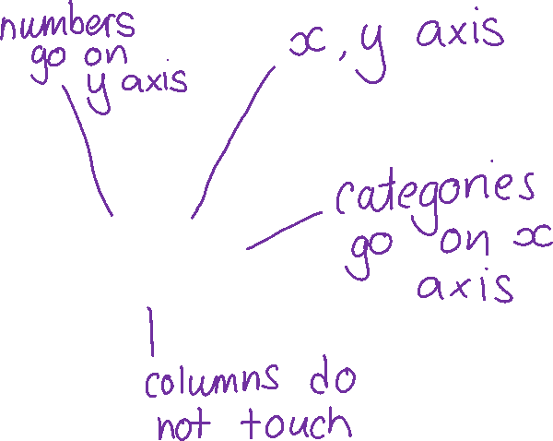
Revision
Brainstorm
Column Graphs
Notes:
An optional revision activity to get the students to brainstorm what they remember about column graphs – try popcorn or limit input to two per person.

Slide 4
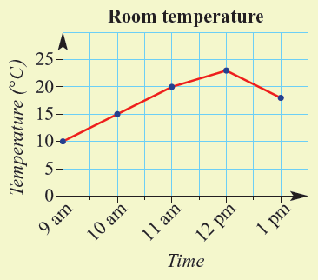

24
7
30
Line Graphs
Date
EQ: What is a line graph and how do we use them to display data?
Questions
Notes
Explanations
What is a line graph?
A line graph shows continuous data.
For example – temperature through the day.

Slide 5
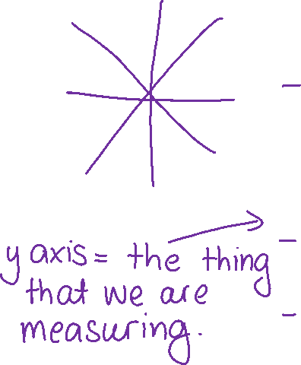
24
7
30
Line Graphs
Date
EQ: What is a line graph and how do we use them to display data?
Questions
Notes
Time | Temperature
9 am | 10
10 am | 15
11 am | 20
12 am | 23
1 pm | 18
Explanations
How do we make a line graph?
List the data points in order.
Draw the axes to fit the data.
Plot the points and connect with straight lines.
Notes:
Note usual time recording places data in order naturally. This is not always the case for all.
You might also like to discuss dependent and independent variables as going on the y-axis and x-axis respectively. Students should have already done this in science.
Important points – Numbers go on the gridlines (not like column graphs). The x-axis does not always start at zero. It will start with our data. The y-axis will start at zero

Slide 6

How does it work?
Age | Height (cm)
9 | 110
11 | 120
13 | 150
10 | 115
12 | 130
Notes:
You might like to use this for a demonstration.
Note that the data is not in order – age will go on the x-axis.
You might like to print this page as two to a page to provide an A5 worksheet for the students to follow along with the demonstration.

Slide 7
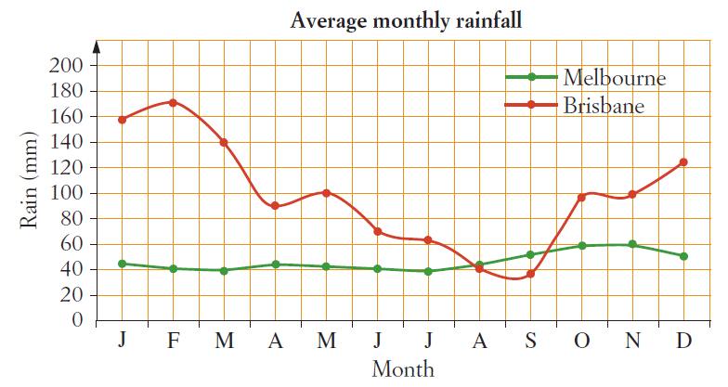
24
7
30
Line Graphs
Date
EQ: What is a line graph and how do we use them to display data?
Questions
Notes
Explanations
How do we read a line graph?
e.g. In what month does Brisbane have an average rainfall of 140mm?

Slide 8
Practice:
What is the average June rainfall for Melbourne?
In what months does Brisbane have an average rainfall of 100mm?

Slide 9
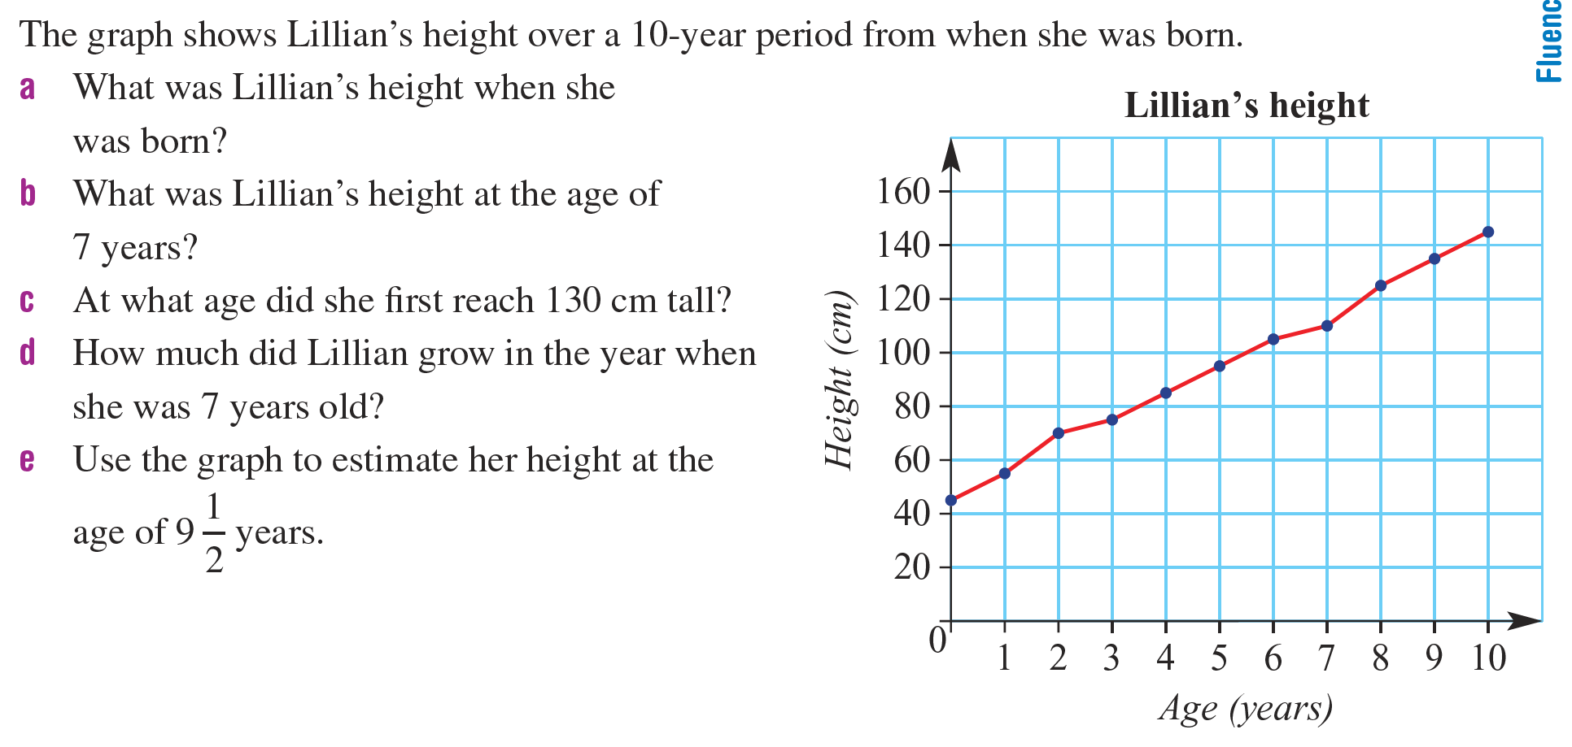
Independent Practice
Notes:
Or you might try Cambridge p407 – there are assorted questions there.

Slide 10
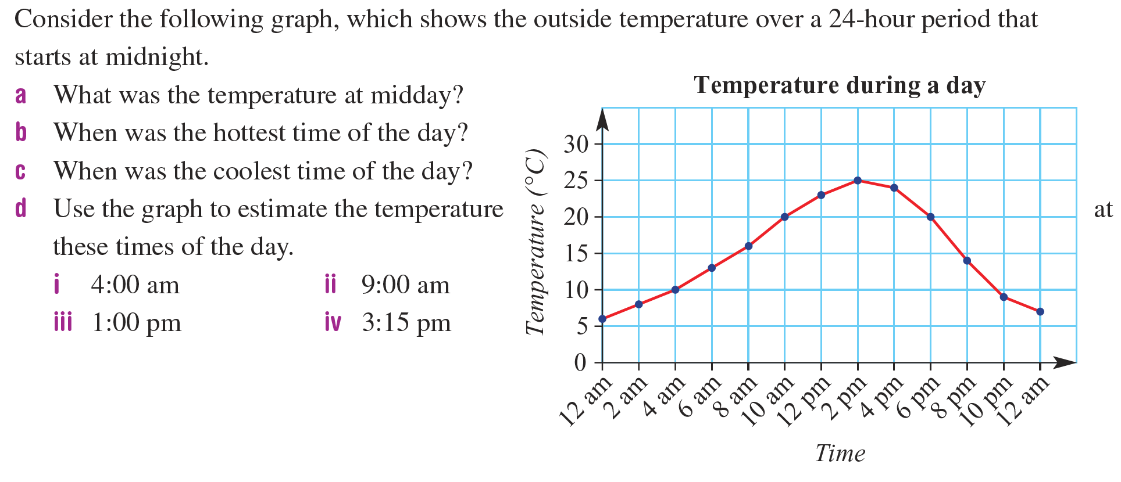

Slide 11
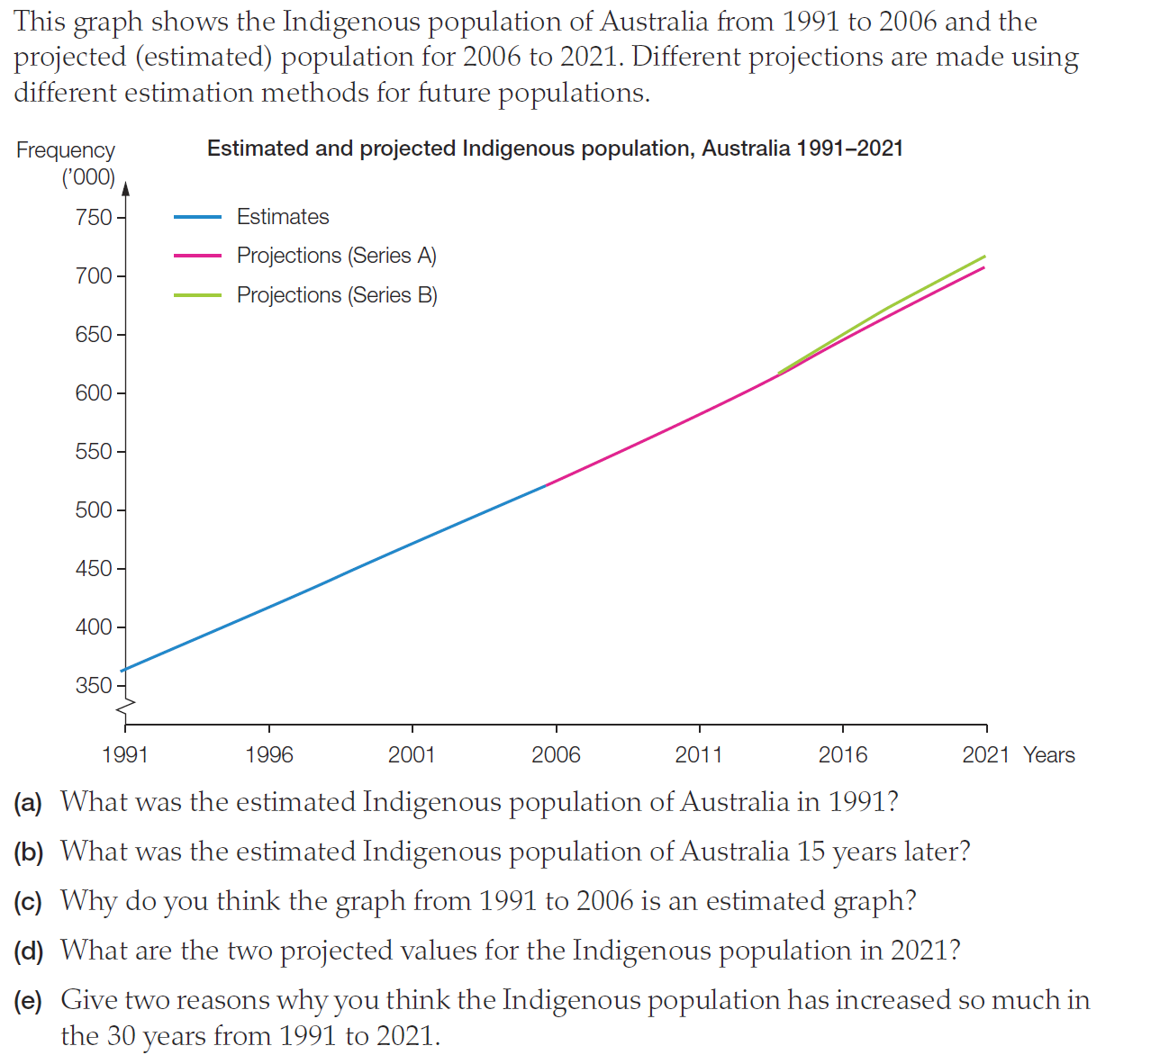
Extension

Slide 12
24
7
30
Line Graphs
Date
EQ: What is a line graph and how do we use them to display data?
Questions
Notes
Explanations
Complete your summary by answering the EQ
Summary
Line graphs display __________ data in ___________________.
They show ______________________________________________

Slide 14
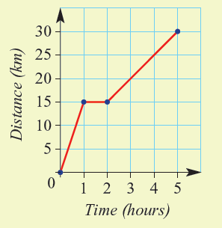
24
7
30
Travel Graphs
Date
EQ: What is a travel graph and how do we use them?
Questions
Notes
Explanations
What is a travel graph?
A travel graph is a special type of line graph.
It shows the distance someone travels over time.
Time on x-axis
Distance travelled on y-axis
Summary
Notes:
You might like to split this pack into two lessons here. That way students become familiar with the concept in the first lesson then explore a specific case in the second

Slide 15
24
7
30
Travel Graphs
Date
EQ: What is a travel graph and how do we use them?
Questions
Notes
Explanations
How do I read it?
Slope = moving
Flat = stationary
Higher slope = travelling faster
Down = moving closer
Find the information you know then follow the gridlines to find the information you want.
e.g. How far had the cyclist travelled after 3 hours?
Follow the three gridline up to the line then across to read 20 km on the y-axis.

Slide 16
How does it work and how do I read it?
30
Distance (km)
25
20
15
10
5
0
1
2
3
4
5
6
Time (hrs)
Notes:
You might like to use this for a demonstration – Get them to create a story using the numbers
a How far was traveled in total? 30km
b How far was traveled in the first hour? 5km
c What is happening in the fourth hour? He is stopped. Why might that be?
d When was the person travelling the fastest? Last hour. Why do you think that might be?
d In the last hour, how far does the cyclist travel? 20km

Slide 17
Travel Graph Story
Miss L decides to take her donkey Daisy for a walk. She and Daisy start at a nice slow walk to the park. Daisy sees a flower on the side of the road and stops for a couple of minutes to eat it.
Miss L then picks up the pace and walks faster to the park because it started to rain a little.
Miss L and Daisy stay at the park for about 30min. Miss L decides to jog home to get some exercise.
The End

Slide 18
Practice
Notes:
Worksheets are loaded on Connect

Slide 19
24
7
30
Travel Graphs
Date
EQ: What is a travel graph and how do we use them?
Questions
Notes
Explanations
Complete your summary by answering the EQ
Summary
Travel graphs display the distance travelled over __________.

